Slide 1
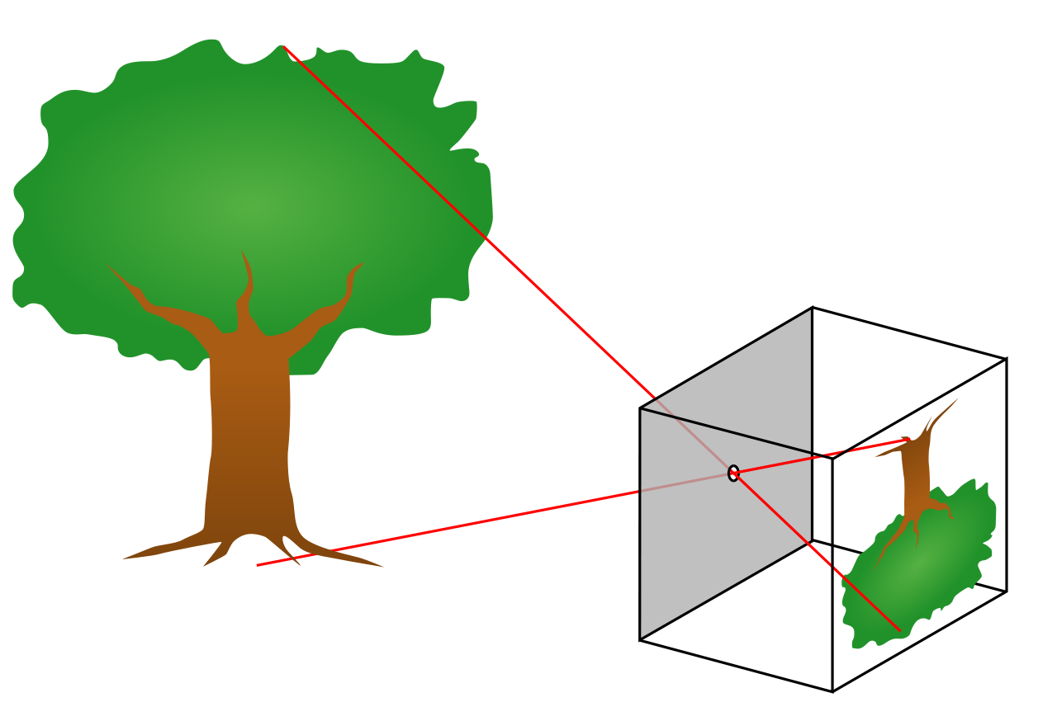
Scientific Method—9 Steps
Mrs. Hoenshell
Science

Slide 2
Topic: Steps to the Scientific Method
Objective: “I can write the steps to the scientific method and be able to explain the differences in the steps and give examples.“
Essential Questions: What is important about the steps to the scientific process? How do we use the steps to test a theory?

Slide 3
Think Time
Without talking, think about a one sentence definition for the scientific method.
DO NOT TALK WITH CLASSMATES!
What is the scientific method?

Slide 4
What is the scientific method?
A process for experimentation that is used to explore observations and answer questions about the natural world.

Slide 5
Natural science seeks to understand the natural world around us and how it works.
There are five major branches of the natural world:
Chemistry
Earth science
Physics
Astronomy
Biology (Life Science)
What is the natural world?

Slide 6
Observations
Gathered through your five senses.
A scientist notices something in their natural world.
1st Step--Observation

Slide 7
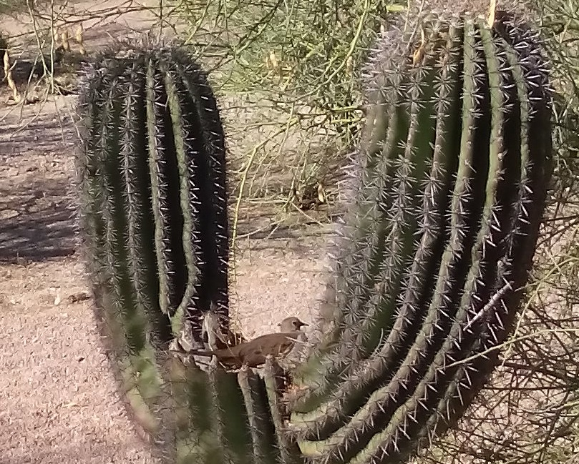
THINK TIME
Look at the picture.
List 3 observations

Slide 8
Question/Problem
Based on what you observed
You wonder why something looks they way it does, acts the way it does, could you do something different.
2nd Step—Question or Stating a Problem

Slide 9
WRITE
Write a question for the 3 observations you made

Slide 10
Hypothesis
Simple answer to your question
Must be testable
3rd Step—
Simple
Answer

Slide 11
Literature Review
Before you can test your theories, it is important to find out information about your theory.
Search for information if any one has ever done this experiment or Asked the same question.
What were their results?
Change your hypothesis based on what you find out
What is the 4th Step of the Scientific Method?

Slide 12
Literature Review
You must find at least 3 different sources
Interview with a professional associated with your theory.
Online resource
Journal/Article
How many sources must you use for your literature review?

Slide 13
Literature Review
With your shoulder partner, list where you could find information for your theories?
List 3 places you would try to find information about your theories.

Slide 14
Deductive Reasoning Statement
What is the 5th step of the scientific method?
A suggested solution to the problem.
Must be testable
Sometimes written as If…Then… statements
Predicts an outcome

Slide 15
Deductive Reasoning Statement
How do I write an If, Then statement?
The if will always be your independent variable
The then will always be your dependent variable

Slide 16
Deductive Reasoning Statement
What is an independent variable?
The independent variable is what you are testing.
If you want to know how much sunlight sunflowers need to grow, your independent variable would be the amount of sunlight.

Slide 17
Deductive Reasoning Statement
The dependent variable is what changes because of what you are testing.
You want to know how much sunlight sunflowers need to grow, your dependent variable would be the amount of growth of your sunflowers.
What is a dependent variable?

Slide 18
Example—Deductive Reasoning Statement
What would be your deductive Reasoning Statement for the sunflowers?
If sunflowers receive at least five hours of direct sunlight each day, then the sunflowers will grow at least one-two inches a week.

Slide 19
Experiment
What is the 6th step of the scientific method?
A procedure called an experiment to test your hypothesis and deductive reasoning statement.

Slide 20
Experiment
What is a valid experiment?
A good or “valid” experiment will only have ONE independent variable!
Conduct several trials

Slide 21
Data Collection and Analysis
What is the 7th step of the scientific method?
Results of the experiment
May be quantitative (numbers) or qualitative (descriptive—harder to prove)

Slide 22
Data Collection and Analysis
What is the 7th step of the scientific method?
Must be organized
Can be organized into charts, tables, or graphs

Slide 23
Graphing Data Collection for Analysis
Y
DEPENDENT VARIABLE
How do I graph my results?
What changes because of what you are testing.
X
INDEPENDENT VARIABLE
What you are testing

Slide 24
CONCLUSION
The answer to the hypothesis based on the data obtained from the experiment.
What is the 8th step of the scientific method?

Slide 25
PEER REVIEW
What is the 9th step of the scientific method?
Peer Review—Submit to a scientific journal.

Slide 26
Summary:
1) Identify a Problem or Question
2) State Observations about the problem
3) Form a Hypothesis
4) Literature Review—Has someone already asked the same question
5) Deductive Reasoning Statement: about the problem (if…then…)
6) Design an Experiment to test the hypothesis
7) Collect Data
8) Form a Conclusion
9) Peer Review

Slide 27
Exit Ticket: You will have a quiz on this. List the 9 steps to the scientific method. Which steps were new to you? Why would those steps be important for your future investigations?

