Slide 1
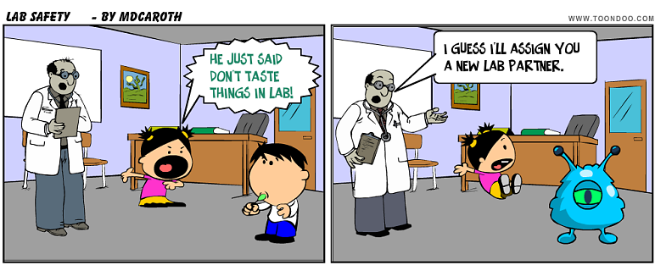
Student Safety Expectations
Mrs. Hoenshell
Science
Middle School

Slide 2

Topic/Objective: Student Safety
Essential Questions: What is student safety and why is practicing safety important?

Slide 3
Goals
List the Student Safety Rules
Give examples of unsafe behavior
Give example of safe behavior

Slide 4
Bellwork
Get a Cornell Note HO and complete on the handout.

Slide 5
Objective: “I can review lab safety rules and write the rules in my composition book using Cornell Notes.”
Classwork: Review and take notes for Lab Safety
Bellwork: On a quarter sheet, what are five UNSAFE behaviors you have seen in the past during science class.

Slide 6
What’s wrong in the picture? List five things.

Slide 7
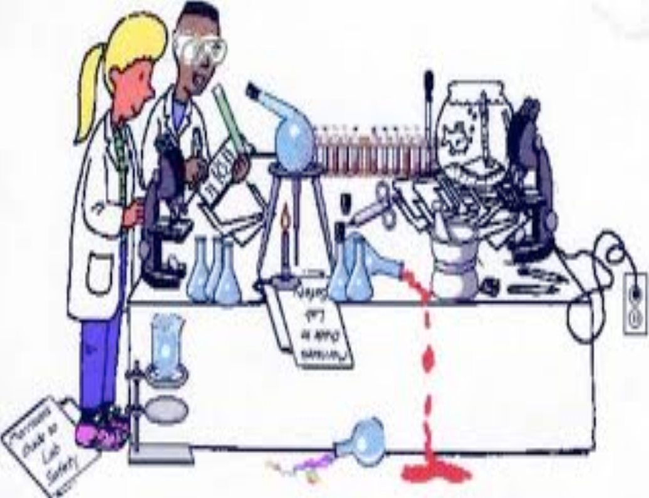

Slide 8
Be Alert
Pay Attention
Proceed with Caution
What is Mrs. H’s Golden Rule for Science?

Slide 9
Read and understand all safety instructions before you begin.
Draw and diagram a picture that explains this rule to you.
Rule #1:
READ

Slide 10
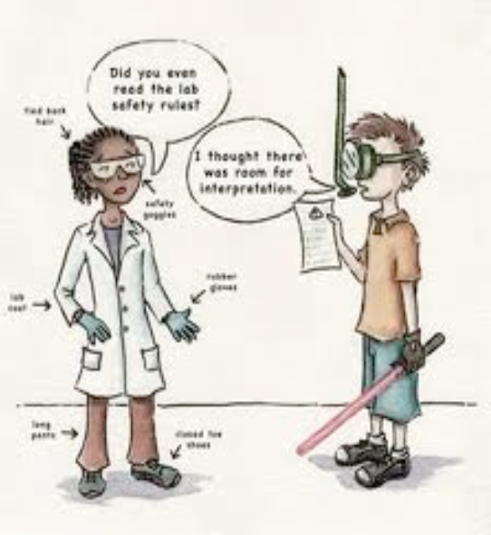
Rule #2:
Follow Directions
Always follow safety procedure outlined in your lab handout.
Follow Directions and ask questions if you are unsure of what to do.

Slide 11


Rule #3:
Safety Equipment
Wear Goggles during all labs.

Slide 12
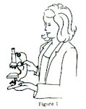
Rule #4:
Equipment
Always carry microscopes with two hands.
Never let lens touch slide or platform.
BE CAREFUL!

Slide 13
Rule #5:
Mouth
Never put any material in your mouth.
Do not taste any chemicals.

Slide 14
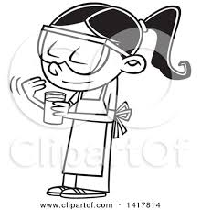
Rule #6:
Smell/Waft
Do not smell any unknown material.
If asked by Mrs. H to smell a substance, wave a hand over the material to draw the scent toward your nose

Slide 15
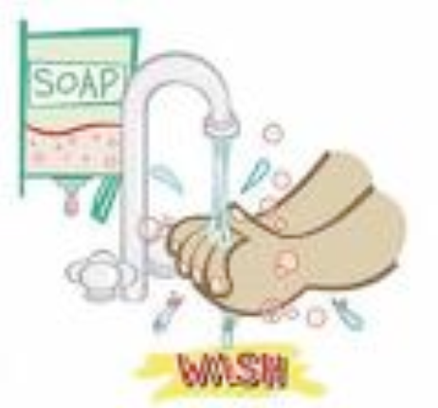
Rule #7:
Wash
Always wash your hands with soap and water immediately after using chemicals (including common chemicals such as salt and dyes).

Slide 16
Rule #8:
Chemicals
Do not mix unknown chemicals just to see what happens without prior permission from Mrs. H.

Slide 17
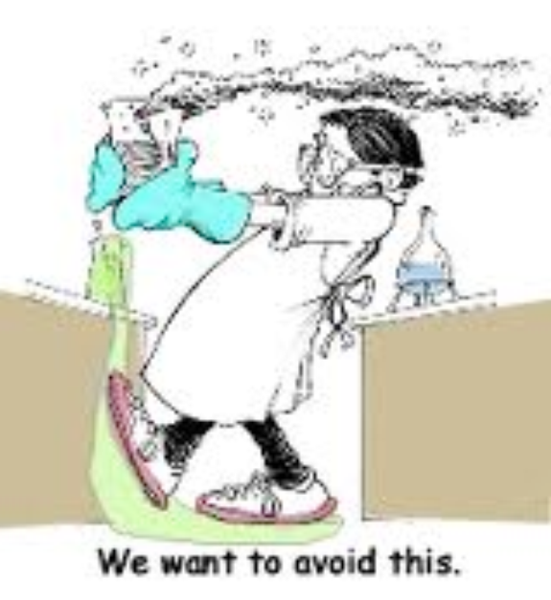
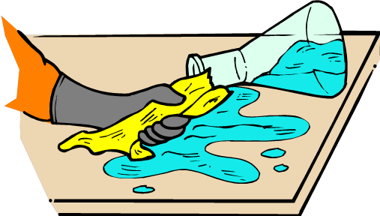
Rule #9:
Spills
Clean up spills immediately and report all spills to Mrs. H.

Slide 18


Rule #10:
Accidents
Report all accidents, spills, and broken glass to Mrs. H.

Slide 19
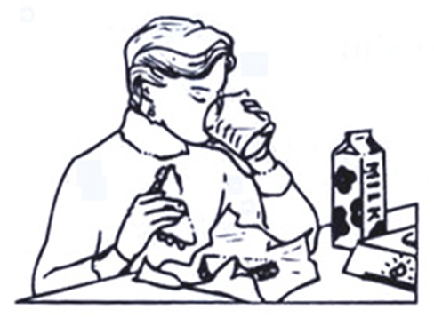
Rule #11:
Food
NO eating or drinking during LABS!

Slide 20

Rule #12:
Horseplay
NO HORSEPLAY in the classroom—this is considered UNSAFE BEHAVIOR and an automatic Referral and call home!!!!!

Slide 21

Rule #13:
Backpacks
Backpacks stay at tables and NEVER are brought to the lab stations.

Slide 22
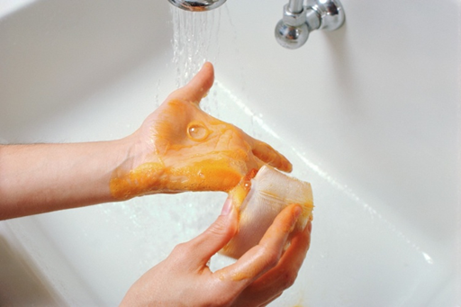
Rule #14:
Clean Up
Clean up your area, tools, and hands when done.

Slide 23
Rule #15:
Equipment
Turn off equipment.
Recycle or dispose of materials properly..

Slide 24



Rule #16:
Dress Appropriately
Long Hair must be tied back.
Loose dangling jewelry must be removed
Must wear closed toed shoes during labs.
Closed -toed shoes

Slide 25
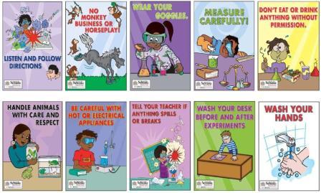
Remember:

Slide 26
Check Your Understanding
What’s wrong with these pictures?

Slide 27
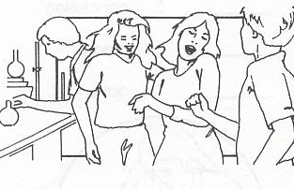

Slide 28
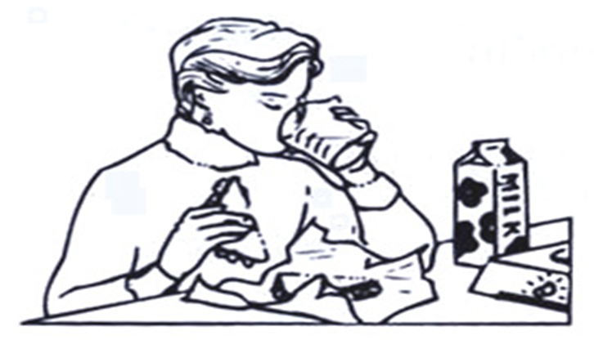

Slide 29
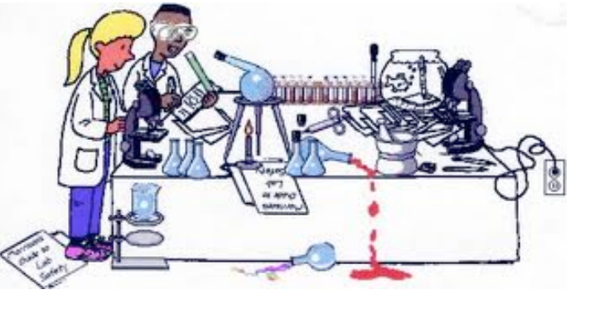

Slide 30
Exit Ticket:
Examine the picture:
On a quarter sheet of paper, write down every lab safety rule violation you can find.

Slide 31
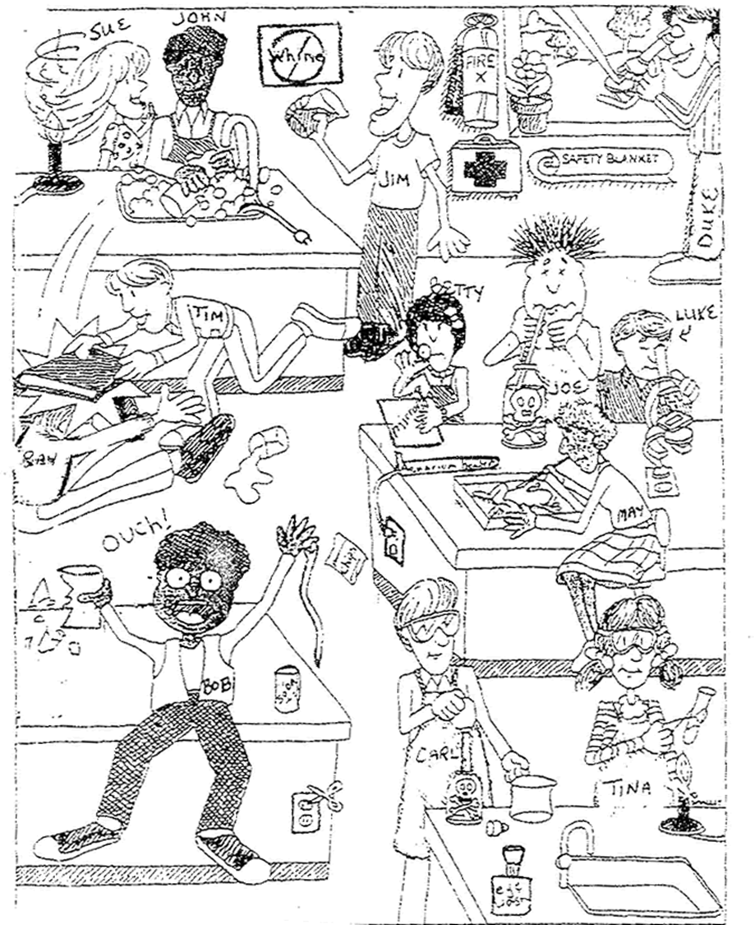

Slide 32
Summary:
Quietly write at least 5 COMPLETE sentences summarizing what you have learned today.

Slide 33
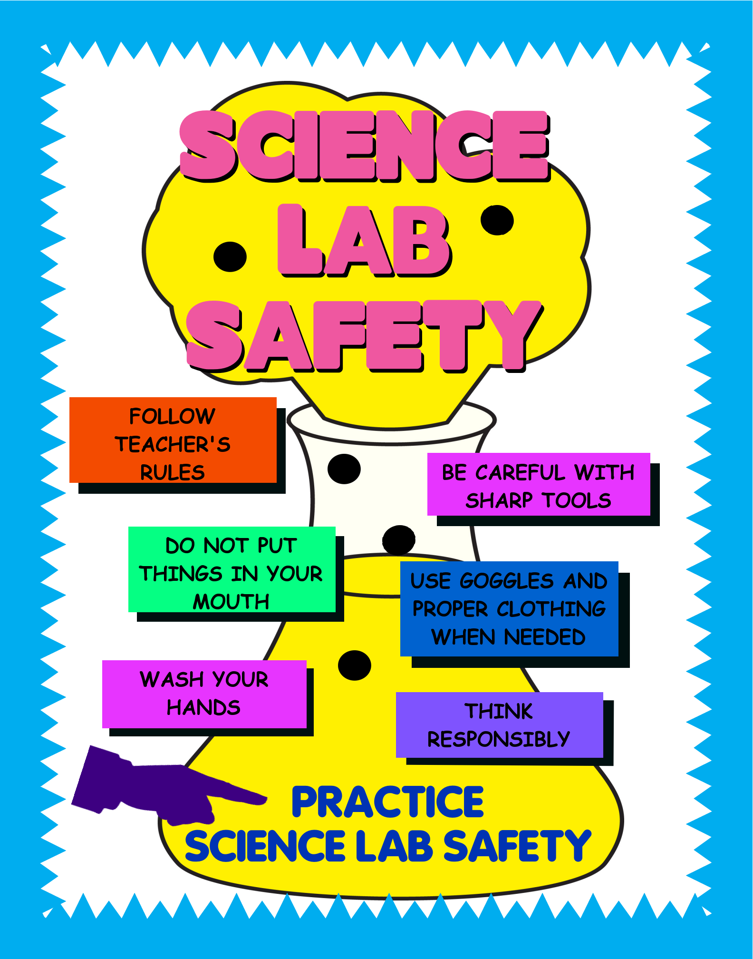

Slide 34
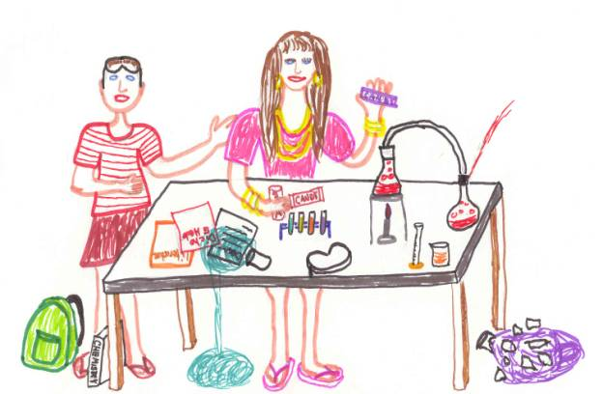
Create Your Own Slogan!

